Slide 1

Superintendent’s Forum
Orange Public Schools
“Good to Great”
Gerald Fitzhugh, II, Ed.D.
Superintendent of Schools
“ The Teaching Superintendent”
September 1, 2020

Slide 2
Beginning with a Moment of Silence
As you know, we have personally lost family members, friends, and extended family as a result of the pandemic we must continue to lean on one another during these trying times.
Before we begin the 2020-2021 Superintendent’s Forum, let us take a moment of silence to honor those that we have lost.

Slide 3
District Great News
NJQSAC Announcement
I am pleased to announce that the Orange Public School District obtained a score of 83% in Curriculum and Instruction on the New Jersey Quality Single Accountability Continuum (NJQSAC) report for the school year 2019-2020. NJQSAC is the Department of Education's monitoring and district self-evaluation system for public school districts. In SY 2018-2019 and as reported to the Board of Education earlier in SY 19-20, our score in Curriculum and Instruction was 74%. Throughout the school year, the Curriculum Directors, Supervisors, teachers, and I embarked on a revision process of all district curriculums. In that particular area of the report, we received a perfect score of 40 out of 40. Per the New Jersey Department of Education, the district has satisfied at least 80% of the weighted indicators in each of the five areas of the NJQSAC review process (Instruction and Programs, Operations, Personnel, Governance, and Fiscal) and has been designated as "high performing. The Commissioner will recommend to the State Board of Education that the Orange Township Public School District be certified as providing a thorough and efficient system of education for three years or until the next NJQSAC review. Congratulations on this accomplishment.
Always remember, there is NO I in TEAM…this is a collaborative effort of our entire school community. Please drive by Rosa Parks Community School as well as the train station on Scotland Rd., we have two billboards up to celebrate our district as one recognized as high performing! We have a lot to celebrate as we enter into SY 2020-2021.

Slide 4
District Great News
NJQSAC Announcement
NJQSAC Areas | Placement August 2020
Instruction and Program | 83%
Fiscal Management | 100%
Governance | 95%
Operations | 92%
Personnel | 100%

Slide 5
District Great News from SY 2019-2020
Orange High School: This summer students participated in a total of 18 credit recovery courses to stay on track for graduation. A total of 86 students completed the credit recovery program and 15 seniors successfully completed their graduation requirements and were able to graduate on July 31.
SAT Math preparation – OHS administrators and staff review of students’ data shows a need for increase students’ participation and scores. To better prepare our students for standardized testing, OHS will now be offering SAT/ACT preparation classes for Math and ELA.

Slide 6

District Great News from 2019-2020

Slide 7
District Great News from SY 2019-2020
Orange Preparatory Academy: First Successful completion of the ECC Cohort 1 first year of college courses with 15 credit hours achieved
Expanded Female Mentor Program - multi-year system of support from grades 8-12
Big growth with ELL students in ELA benchmark assessments
  ELA Proficiency Rate ELL
Unit 1- 8th – 14%; 9th – 0%
Unit 2 - 8th – 14%; 9th –27%
Unit 3 - 8th – 20%; 9th –50%

Slide 8
District Great News from SY 2019-2020
STEM Innovation Academy of the Oranges: 97% of 11th graders have already met New Jersey's graduation requirements for assessments.
STEM Innovation Academy of the Oranges participated in the AMTNJ Math Competition and won first place overall.
STEM Innovation Academy of the Oranges was recently recognized by PLTW for innovative program and will be presenting at their National Conference in Indianapolis, IN in February.
Chinese Delegation visited STEM Innovation Academy of the Oranges in the effort of viewing sound instructional practices and curriculum. What a visit; what a day.

Slide 9
District Great News from SY 2019-2020
Oakwood Avenue Community School: In May 2020, students were recognized for having 100% participation in their Google Meet Assignments and completed their class assignments daily. Students names were placed in a random drawing and four students were selected to receive a pizza dinner.
The Oakwood Bridge Team along with the Park Avenue Bridge Team traveled to Las Vegas in July 2019 to participate in the annual international competition. The kid’s enthusiasm and excitement was electrifying. In addition to competing with people from all over the world the students also had a chance to do some site seeing. They did the Hop on Hop off city tour taking a group picture under the famous Las Vegas sign, in addition to touring Red Rock Canyon and the exotic atrium of the Bellagio Hotel. They also visited the Grand Canyon and the Hoover Dam.
Ms. Ericka Stevenson, Community School Coordinator hosted a Virtual Story-time that coincided with Read Across America. Each week a different staff member went on Facebook Live to read a story to the students. Now this is “Good to Great.”

Slide 10
District Great News from SY 2019-2020
Heywood Avenue School: For the 3rd year in a row, Heywood Avenue received Project Lead the Way Distinguished School status. This honor is bestowed upon schools who demonstrate commitment to increasing student access, engagement and achievement in their PLTW programs.
In February, Heywood’s middle school students celebrated Engineering Week by engaging in Skype and in-person presentations from University professors, undergraduate and graduate students from Stevens Institute of Technology, Rowan University, Princeton University and the University of Delaware. Their week-long celebration and learning culminated in a walking field trip for 7th grade students to the STEM Innovation Academy of the Oranges where they shadowed current students, some of whom were Heywood alumni, to learn about the high school offerings provided there.
On March 6th, Heywood celebrated Black History Month by transforming the entire school into a replica of the National Museum of African American History and Culture. Our K - 2 students created classrooms and hallways of African American achievement and contributions, while students in grades 3 - 4 provided key information on the Underground Railroad and the Abolitionist movement and students in grades 5 - 7 focused on the Civil rights movement. Through oration, music and dance, the entire Heywood community of staff, students and parents learned through our theme of “From Struggle Comes Strength” the power of the African American experience.

Slide 11
District Great News from SY 2019-2020
Park Avenue School: Students created an interactive Ocean Museum. What was so awesome about the event was that students were the instructors and informed the invited guests of the importance of recycling and the negative effects of the ocean should we not.
In February, 2020, students and staff participated in the Black Lives Matter Assembly. The sweet sound of music and the history bestowed on the school community made each of us in attendance proud.
In the foyer of Park Avenue, the school recognized all students. It was a beautiful display of the accomplishments of the students as a whole. The day of the unveiling was touching; allowed for the school to come together and recognize the greatness of all.

Slide 12
District Great News from SY 2019-2020
Scholars Academy: Pre-Kindergarten students enjoyed the sensory hallway experience as they hopped on logs, stomped on numbers, tiptoed on shapes, and pressed their wiggles out onto the wall.
Scholars Academy was selected from NJEA to receive a special visit from the Cat in the Hat himself which coordinated with the 100th day of school celebration.
No matter the virtual distance, Preschool staff continued with Science experiments for Preschool students with weekly videos for students to participate in such as Dancing Spaghetti and Float/Sink!
Principal Machuca was selected as New Jersey Association for Gifted Children (NJAGC) Administrator of the Year for 2020!

Slide 13
District Great News from SY 2019-2020
Orange Early Childhood Center: Sensory Hallways and Walkways are so very important. At a glance, children need these hallways and walkways to center themselves. At Orange Early Childhood Center, the students embarked on the usage of the hallways.
Prior to the pandemic, perfect attendance classroom shout outs took place. The children waited to hear if their classroom had perfect attendance - you could hear them clapping and shouting as the announcements were made. It was so popular, that families would come in asking if their class had perfect attendance. Orange Early Childhood Center had great incentives for the children, families, and staff to celebrate attendance. Mrs. Blanton is quoted by the following, “I think having the entire building focus on attendance made a major difference.”

Slide 14
District Great News from SY 2019-2020
Lincoln Elementary School: The continuation of our weekly SEL meetings (in grades 5-7) from March 2020 - June 2020 provided targeted students with the supports they needed to continue to be successful during the school year given the climate we were placed in.
Student participation during Lincoln’s virtual spirit weeks increased over the course of distance learning. The school community was proud and excited to see what students created.
Lincoln Avenue students placed in 1st - 3rd place in the final 4 weeks of the Problem of the Week contest for mathematics. We are very proud of their hard work and determination.

Slide 15
District Great News from SY 2019-2020
Forest Street Community School: During the 2019-2020 SY there were some notable highlights from Forest Street Community School. As per Dr. Cooke, she reflected on the following: “The first item that comes to mind is the dedication and efforts of the Forest Street staff during the pandemic phase of the school year. When you use the proverb it takes a village it describes the time, energy and efforts that our teachers used to provide rigorous instructions and social and emotional supports throughout distance learning.
We went from “I teach you… to a you teach me as we learned together” format through the application of technology that was student led
Ms. Edwards consistently provided self-care to students and staff in collaboration with the nurse. Weekly health checks were conducted by Nurse Hydah.
Ms. Irving provided one-on-one trainings for parents, students and staff to ensure that technology platforms were being utilized effectively.

Slide 16
District Great News from SY 2019-2020
Cleveland Street School: Kindergarten and 7th Grade Moving Up and Moving On - In-Person DriveBy/DropOff (Awards, Promotional certificates, and incentives)
Virtual Summer Student Recognition Programs (Grade Levels: 3rd & 4th and 5th through 7th)
Virtual Student of the Month Programs
Virtual Social Emotional Supports Programs

Slide 17
District Great News from SY 2019-2020
Rosa Parks Community School: Ms. Alexander is an Art teacher at RPCS. She was contacted by ABC, channel 7 news network, to highlight how she empowers our students and exposes them to inclusive art history lessons. https://abc.com/shows/localish/episode-guide/season-01/600-this-teacher-is-empowering-children-through-art
RPCS Branding- Dr. Joseph-Charles communicated that she wanted the staff to highlight all the beautiful things that are taking place in our classrooms via social media. Twitter is a great way to help market our school, improve public relations, and bring the classroom to the community. Since then, we have had 40 staff members, at least one from each grade level, showcasing the fantastic work being done at RPCS. Our Twitter feeds are filled with amazing art projects from our students, teachers’ TikTok videos to increase student engagement, STEM activities, students reading, school spirit day pictures from students and staff, student work from all subjects, students being physically active, etc. The Twitter world now knows the work that is being done at Rosa Parks Community School.

Slide 18
District Great News from SY 2019-2020
Rosa Parks Community School: Virtual Space at RPCS – Our staff members went over and beyond to ensure that students continued to learn during remote learning. As showcased on Twitter, teachers used many virtual platforms to conducted unique learning experience for our students. Our staff used Padlet, FlipGrid, Youtube, Kahoot, TikTok, Screencastify, created interactive Google Slides, etc. Some examples are below:
  Mrs. Pais, 7th-grade Social Studies teacher, decided to give her students voice, promote collaboration, and integrate technology into a learning experience through Padlet to do her Pandemic Experience Project. https://padlet.com/clepinski/8z2ewqa7hslm7zoa
  Ms. Kober, 4th-grade Math teacher, learned many new virtual platforms that she integrated them throughout remote learning.
  The Physical Education department conducted our very first virtual field day.
  The school also had two successful moving up ceremonies virtually as well as many other end of the year celebrations.

Slide 19
District Great News from SY 2019-2020
  Rosa Parks Community School: Virtual PDs- Mrs. Vaughan, RPCS Technology Coordinator, rose to the occasion when our district was forced to go remotely in March. Since we could not send our staff to learn the best technology practices, Mrs. Vaughan and her district colleagues decided to bring the district's learning to them. She provided PD to give instructional support through technology and introduce the district's staff to engaging student programs while learning virtually. The staff was provided PD on the following platforms: Adobe Spark, BrainPop, Vocabulary Spelling City, FlipGrid, Google Meet, Discovery Education, Jamboard, Seesaw, Padlet, Newela, Pear Deck, Google Classroom, Kahoot!, Snap & Read, and ClassDojo. https://docs.google.com/presentation/d/13wpquSfxf8sb586S4bYwsUkpV847rFfqXNZeAkdMLPM/edit#slide=id.g88b898dbae_0_7

Slide 20
District Great News from SY 2019-2020
Newcomers Academy: In November, Chef Torres and his culinary students hosted a Thanksgiving Feast for all Newcomers’ students and their families. Close to 90 people attended and enjoyed the dinner. Ms. Alvarado, 6th and 7th Grade ESL Teacher reached out to her Chatham Community via Facebook. Most of students and their families did not have the winter clothing they would need because they came from warmer climates. On behalf of the Chatham Community and Newcomers’ we were able to give away over 100 winter coats and also winter clothing to students and their families. Most of the coats were brand new.
Ms. Guerra and Ms. Farez’s Bilingual Spanish Kindergarten students and Ms. Alvarado’s 6th and 7th grade ESL students each performed a reenactment of Rosa Parks and the day she decided not to give up her seat on the bus. Both performances were outstanding and performed all in English. The performances not only highlighted the courage, acting skills, and creativity of our students but their major progress in the English language by the middle of the school year prior to the emergency school closure.

Slide 21
District Great News from SY 2019-2020
Office of Curriculum and Instruction: World Languages: AP Spanish: Percent passing 92.8%
During virtual learning, in addition to teaching their own classes, World Language teachers served as interpreters for parents and monolingual colleagues.
Career and Technical Education:
Health Science students, under the tutelage of Mrs. D. DePalma won HOSA regional awards.
Animation, Interactive Technology, Video Graphics and Special Effects: 25 of Ms D. Earle’s students won monetary awards at the Orange High/SOMA Film Festival, coordinated by our community partner Mr. Richard Stephen Bell.
Culinary: Dennis Abrego, Ayotunde Giwa & Malayjah McBean won gold medals at the SkillsUSA Meals Ready to Eat (MRE) Regional Competition under the guidance of Mrs. N. Badruddin.
Navy Junior ROTC: Chief Sperduto’s cadets received an outstanding review when NJROTC Area 4 Commander Miller inspected the program.
Juniors and seniors earned dual enrollment credits from Syracuse University, Rutgers University, and Fairleigh Dickinson University.

Slide 22
District Great News from SY 2019-2020
Office of Curriculum and Instruction: Social Studies: AP US History: Percent passing (scores of 3-5) increased from 0% to 61.1%
2020 Law Day Winners: Mrs. Gengaro’s STEM students won Honorable Mention: Dylan Brooks and Rebecka Francois
Hamilton: Ms J. Jackson’s OHS students won tickets to see Hamilton on Broadway from the Gilder Lehrman Foundation
Health and Physical Education:
Students in Kindergarten through grade 12 participated in the second annual District Field Day. This year it was virtual and had excellent participation on Flipgrid.
Visual and Performing Arts:
The OBE collaboration with Luna Stage continues to bring real life application of drama skills and script writing to the students.

Slide 23
Great District News from SY 2019-2020
Office of Curriculum and Instruction: Instructional Technology:
The International Society for Technology in Education (ISTE) selected Orange Technology Coordinators to present at their work with sustainability at the annual convention. The convention has been postponed from June 2020 until late Fall 2020.
Technology Coordinators organized the deployment of over 1,500 devices for virtual learning and established protocols for online learning.
Health and Physical Education:
Students in Kindergarten through grade 12 participated in the second annual District Field Day. This year it was virtual and had excellent participation on Flipgrid.

Slide 24
Great District News for SY 2019-2020
Office of Language Arts/Literacy: In January and February 2020, selected teachers and administrators participated in the K-2 Literacy Curricular Resource Adoption. The staff worked with varying vendors before ultimately selecting HMH Into Reading. Way to go team!
On March 7, 2020, "Literacy: It All Counts!" District-wide Family Literacy Event in collaboration with Community Engagement Office.
On June 10, 2020, 5th graders interviewed the Mayor and the Superintendent on the town and school district responses to the pandemic. The students certainly had a set of great questions and pushed for sound responses.

Slide 25
Great District News from SY 2019-2020
Office of Human Resources: Personnel received a score of 100% evaluation rating under our NJQSAC audit from SY 2019-2020.
Human Resources developed a successful virtual job fair during the pandemic to assist with recruiting and hiring.
Human Resources successfully transitioned the on-boarding process from onsite to electronic.

Slide 26
Great District News from SY 2019-2020
Office of Special Services: College Fair & Resources-The guidance department developed virtual resources to support the college application process. The virtual resources include the:
Online admissions materials
Access to college preparation resources
Financial aid and scholarship links
Virtual college tours, videos of admissions counselors, guest speakers and other leading professionals
Students utilized the on-line application resources to complete their college applications.

Slide 27
Great District News from SY 2019-2020
Office of Special Services: Extended School Year (ESY)
Students participated in the 2020 ESY summer learning and fun program through a virtual platform. Students explored learning through project-based activities focusing on English Language Arts and Mathematics with the integration of technology. Students explored thematic themes such as oceans, rainforest, re-cycling, water cycle, animal/farms, presidential election and college explorations. Each class attended several virtual field trips aligned to their thematic theme. At the end of the program students presented their thematic unit through a virtual showcase with over 100 plus participants including students, teachers, and family members. The ESY staff is commended for their hard work and dedication to ensure students’ progress both academically and social emotionally.

Slide 28
Great District News from SY 2019-2020
Office of Mathematics and Science: Students enrolled in the Advanced Placement Courses (Calculus AB & BC) achieved 100% passing!
Dr. Powell and I worked closely with Rutgers-Newark as well as Apple Electronics in regards to a donation of computers for our continued work with computer science. This is a high school initiative and as a result of the team’s due diligence and creation of a sound computer science plan, we received a donation of $219,000.00 in Apple products for the following schools: Orange Preparatory Academy, STEM Innovation Academy of the Oranges, and Orange High School.
Last school year, the department embarked on a partnership with Students to Science. This initiative was for Grades 5-12. We are continuing this work for SY 2020-2021. Our students were able to work closely with scientists in the field to stretch their thinking. From virtual instructional supports to engaging at the Students 2 Science facility in East Hanover, students were engaged in rigorous; scientific explorations.

Slide 29
Thank You Staff
As we began in a normal fashion last year, on March 17, 2020, our world experienced a pandemic. We had to figure out this thing called “distance learning.” Through common planning meetings, discussions with one another, chit-chats with our families and students we used the summer months to redefine what “remote learning” must sound, look, and feel like.”
Through the summer program 2020, we added nuances to improve practices during the course of the summer. Parent comments that were emailed to the Superintendent of Schools: “I like the real time learning.” “My child loved seeing his teacher.” “I feel that Orange is ahead of many districts. Please tell the staff thank you.”
Special thank you to our essential staff during the first leg of the pandemic….Thank you to our security and food services personnel. Staff from PCI as well as members of varying offices at the Administration Building who worked around the clock to provide supports to our school community and continue to do as such.
Your continued commitment to the craft called “teaching and learning” is certainly appreciated. Always know we are in this together.
Welcome to the New Staff!!!!! We are so excited to see you today virtually…..

Slide 30
Advanced Placement Scores
SY 2019-2020
Gerald Fitzhugh, II, Ed.D.
Superintendent of Schools
“ The Teaching Superintendent”
September 1, 2020

Slide 31
High School AP Results
School Year | # of Exams Taken | # Passing (score of 3-5) | % Passing
2015 | 156 | 25 | 16.0%
2016 | 154 | 36 | 23.4%
2017 | 155 | 45 | 29.0%
2018 | 181 | 88 | 48.6%
2019 | 168 | 93 | 55.4%
2020 | 123 | 71 | 57.8%
Notes:
The total for 2020 includes OHS and STEM.

Slide 32
AP Results by Subject
% passing with a score of 3-5
Subject | 2016 | 2017 | 2018 | 2019 | 2020
Calculus AB | 63.6% | 87.5% | 96.4% | 95.2% | 100%
Calculus BC | 50% | - | 93% | 94.1% | 100%
Computer Science A | - | 100% | 25% | 0% | 36.4%
Computer Science Principles | - | 50% | - | 52.9% | 33.3%
English Language and Composition | 6.5% | 9.4% | 35.3% | 60% | 15.4%
English Literature and Composition | 15.4% | 13% | 8.7% | 23.1% | 41.2%
French Language and Culture | 44.4% | 50% | 50% | 40% | 60%
Spanish Language and Culture | 76.5% | 85.7% | 78.9% | 94.4% | 92.8%
U S History | 3% | 3% | 0% | 0% | 55.6%
World History | - | - | 18% | 37.5% | 35.3%
Subjects not tested
Chemistry | 2016 | 0% | 2017 | 0%
Music Theory | 2017 | 0% | 2018 | 25% | 2019 0%
Physics | 2016 | 0% | 2017 | 25% | 2018 0%
Notes:
2020 Computer Science A is STEM, Computer Science Principles is OHS and was an independent study completed by 3 students. 2018 Computer Science Principles was not taken because this course is based on interest and was an independent study in 2018. It was a scheduled course in 2019 and an independent study again in 2020.

Slide 33
District Updates
On July 9, 2020, we held a district virtual Reopening of Schools Zoom Roundtable. Over 270 participants were part of the conversation. There were over 100 questions and/or comments in the Zoom Chat.
We had additional meeting on July 15th and July 16th for community feedback as well as July 28th at the Curriculum Committee Meeting which was lived streamed as well. On August 10th the town hall meeting took place. At that meeting, the team announced Plan B for consideration after meeting with both unions, family discussions, survey results, staff, students, and discussions with health officials. Thank you stakeholders for your continued input.
Thank you to Ms. Paiz and Mr. Speker for translating throughout the pandemic….Your work throughout the pandemic has not gone unnoticed.

Slide 34
District Updates
Summer School Programming has taken form district wide. I can say this, implementing synchronous approaches to learning on a daily basis has allowed students to reconnect with their classroom teachers.
Professional Development for teaching staff has continued throughout the summer as well. I am certain we are ready for the launch of SY 2020-2021.
We have continued to implemented school spirit and pride days throughout the summer program. What a great time this has been for our students and staff. Now, that the year is beginning, we have to continue to celebrate our district through displaying our narrative. Please continue to follow us on Facebook, Twitter, and Instagram accounts. We are posting multiple times per day. The district made a promise to consistently give updates and that we are certainly doing. Special thank you to Ms. Purkiss and Mr. Devone for updating our school community throughout the summer. Your dedication has not gone unnoticed. To our staff who are posting daily on Twitter…your messages continue to speak volumes! Thank you thank you thank you.
As members of the Orange Township Public Schools, we need to keep in mind that we are far stronger together than when we are apart. We know we will get through all of this and thrive if we commit to working together, to support the lives of our students. We must hold our heads up high, take each other’s hands, and move forward into a better future. Dr. Fitzhugh

Slide 35
District News-Breakfast/Lunch Grab and Go Update
Please be reminded of the summer food locations beginning at 7:30 AM and concluding at 1:30PM
Rosa Parks Community School
Lincoln Avenue School
Forest Street Community School
Scholars Academy

Slide 36
District News-Breakfast/Lunch Grab and Go Update
Please be reminded of the summer food locations beginning at 7:30 AM and concluding at 1:30PM
Heywood Avenue School
Orange Early Childhood Center
Park Avenue School
Oakwood Avenue Community School
We are having a large push for lunch applications; please assist with the completion as they must be submitted by our families on September 25th.

Slide 37
Purpose of the
Reopening of Schools Committee
On Friday, June 26, 2020, Governor Murphy announced that school will reopen in September, keeping in mind health precautions to ensure the safety of all students and staff. With that being said, the Reopening of Schools Plan will incorporate the voices of staff, Board of Education Members, health officials, and families. These representatives will evaluate the state guidelines and requirements released by Governor Murphy in order to provide input and recommendations into the district’s reopening plan. As stated by Governor Murphy, “there is no one-size fits all approach to suit the unique challenges faced by each school district across the state.” Note: In August 2020, the Governor provided guidance as it related to school opening but in remote situations.
Per the Road Back Document released by the New Jersey Department of Education, there were 4 key areas for discussion:
1. Conditions for Learning 2. Leadership and Planning 3. Policy and Funding 4. Continuity of Learning

Slide 38
The Committee’s Work
As a committee, we delved into the following areas:
Social Emotional Learning (SEL)
Curriculum Programs
Health and Safety
Technology
Funding
Athletics, Co-Curricular as well as Before and After School Programs
Facilities and Operations
Required Student Transportation

Slide 39
Committee’s Stakeholders
District and school-level administrators
Board of Education Members
Presidents/designees of local associations (Orange Education Association as well as Orange Administrators and Supervisors Association-District Unions)
Content experts
Educators
Parents
Students

Slide 40
Stakeholders’ Voices
As described regarding strategic plans, the following outlines the benefits when creating a sound plan:
It allows organizations to be proactive rather than reactive.....
It sets up a sense of direction.....
It increases operational efficiency.....
It helps to increase stakeholder input…

Slide 41
Reopening of Schools
Plan B was recommended to the Board of Education on August 11, 2020.
Remote Synchronous will begin the school year September 8, 2020 through October 2, 2020 (4 Weeks)
Remote Synchronous will commence on October 5, 2020 and conclude on November 25, 2020 (7 Weeks)
Soft Launch will commence on November 29, 2020 and conclude on December 23, 2020 (3.5 Weeks)
Full Re-Entry will commence on January 4, 2021 through the end of the year.
It is important to note: Based on recommendations from the Governor’s Office, the NJDOE as well as our Director of Health in Orange Township, shifts in the plan can potentially take place.

Slide 42
Reminders to the School Community
For further supports, please be reminded that we have created an email address reopeningofschools@orange.k12.nj.us for questions or concerns during this pandemic period as it relates to any facet of the plan or support needed. Responses will be generated within 24-48 hours of receipt.
It is encouraged that you continue to visit our district COVID-19 Resources Tab on the district website www.orange.k12.nj.us for additional resources for families on mental health as well as updates on self care for students, families, and staff. We have posted instructional supports within the COVID-19 Resource Tab for your assistance. As you are aware, we update our COVID-19 Resource Tab weekly in the effort of providing further supports for our school community. Thank you to the Trauma Informed Team for supporting this work since March 17th.

Slide 43
Orange Public Schools
Student Safety Data System
Report Period II
January 2020-June 2020
Gerald Fitzhugh, II, Ed.D.
Superintendent of School
September 1, 2020

Slide 44
Overview
of
Student Safety Data System

Slide 45
What is Collected?
Incidents occurring on school grounds
  Violence (assault, fight, robbery, sexual assault, etc.)
  Vandalism (arson, computer trespass, theft, trespass, etc.)
  Substance offense (possession, sale and/or distribution)
  Weapons offense (air guns, toy guns, bb guns or pellet guns)
Incidents occurring on and off school grounds
  Harassment, intimidation, or bullying (HIB)
  Other incidents leading to removal
      HIB trainings
      HIB programs
Notes:
The SSDS will collect incidents of violence, vandalism, weapons offenses, and substance offenses occurring on school grounds. The SSDS will collect incidents occurring on and off school grounds of: harassment intimidation or bullying, and any other incident leading to student removal from school. School grounds includes more than just the school building. For example, school grounds includes the school bus, off-campus school events such as field trips, and school sponsored events such as football games.

Slide 46
When Do We Report
All New Jersey Public Schools must report twice in a school year:
  Report Period 1: September - December
  Report Period 2: January – June
Notes:
All public schools in New Jersey, as well as all approved private schools for students with disabilities, must report annually to the SSDS. Public school districts must certify that all schools in the district have reported to the SSDS at the end of report period 1, and again after report period 2 to certify reporting is complete and accurate for all schools for the entire school year.

Slide 47
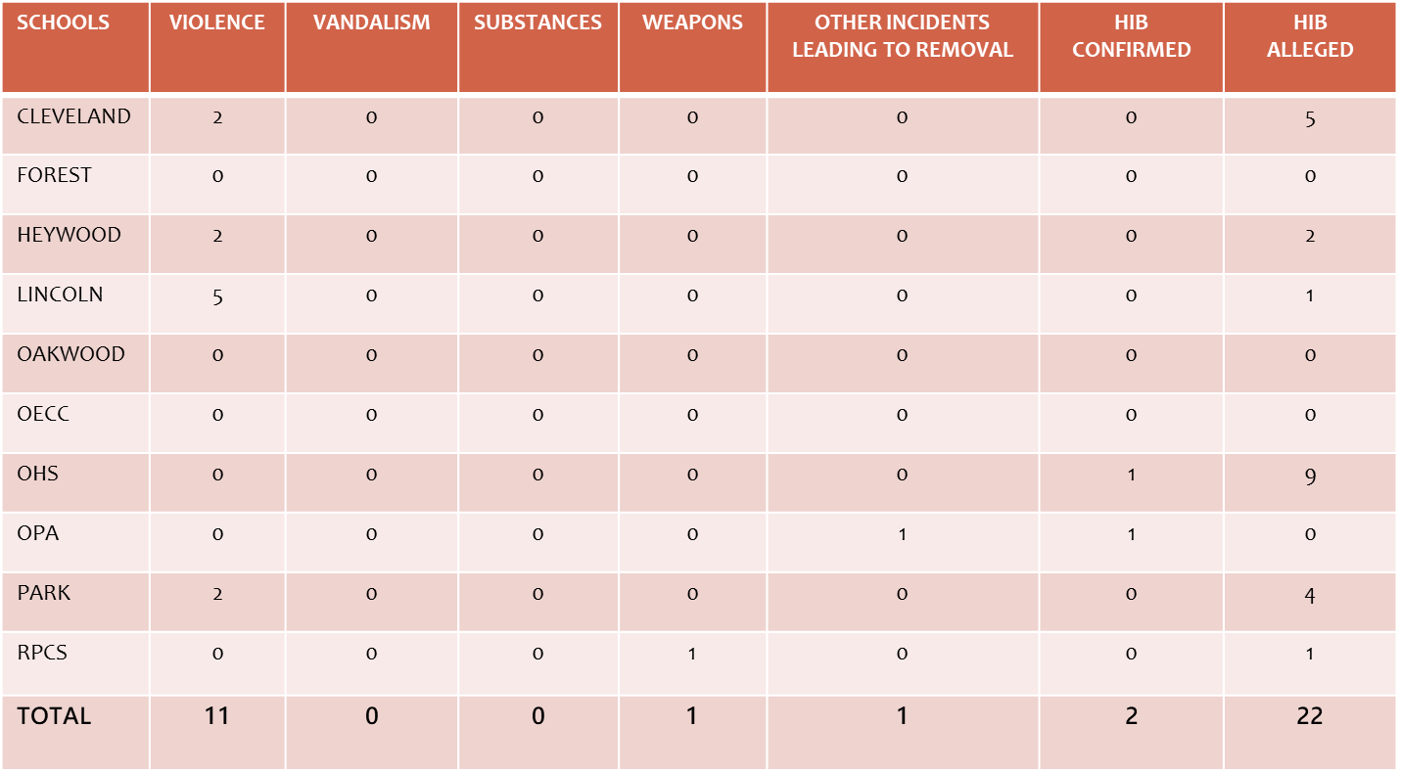
SSDS - Reporting System Results
September 2019 – December 2019
Reporting Period I

Slide 48
SSDS - Reporting System Results
January 2020 – June 2020
Reporting Period II
SCHOOLS | VIOLENCE | VANDALISM | SUBSTANCES | WEAPONS | OTHER INCIDENTS LEADING TO REMOVAL | HIB CONFIRMED | HIB ALLEGED
CLEVELAND | 0 | 0 | 0 | 0 | 0 | 0 | 1
FOREST | 0 | 0 | 0 | 0 | 0 | 0 | 2
HEYWOOD | 0 | 0 | 0 | 0 | 0 | 0 | 4
LINCOLN | 1 | 0 | 0 | 0 | 0 | 0 | 0
OAKWOOD | 0 | 0 | 0 | 0 | 0 | 0 | 0
OECC | 0 | 0 | 0 | 0 | 0 | 0 | 0
OHS | 1 | 0 | 0 | 0 | 0 | 0 | 4
OPA | 0 | 0 | 0 | 0 | 0 | 0 | 0
PARK | 0 | 0 | 0 | 0 | 0 | 0 | 0
RPCS | 0 | 0 | 0 | 0 | 0 | 0 | 0
TOTAL | 2 | 0 | 0 | 0 | 0 | 0 | 11
 |  |  |  | 2011 - 12 | 2012-13 | 2013-14 | 2014-15
NUMBER OF HIB INCIDENTS |  |  |  | 1 | 23 | 13 | 13
10 Day Investigation completed |  |  |  | 1 | 23 | 13 | 13
Affirmed by BOE |  |  |  | 1 | 23 | 13 | 13
Notes:
Commisioner’s Annual Report consist of Violence – Vandalism – Weapons – Substance Abuse – HIB

Slide 49
Orange Public Schools
SSDS Prevention Methods
Restorative Practice
Positive Behavior Supports
Character Education
Social Decision Making
Social Problem Solving
Bullying Prevention
Require SSDS with monthly suspension reports
Consistency in code of conduct rule enforcement
Maintain integrity of residency & guardianship requirements
Substance and Drug Awareness and Prevention for Students, Parents and Community
Notes:
The following are a few of the Orange Public School SSDS prevention methods

Slide 50
Social Emotional Supports
Social Emotional Supports during this time is critical to the landscape of the distance learning plan.
The following information for additional supports outside of the school through our social media handles as well as website and staff communication to families: Mental Health Resources-To access mental health services contact Performcare at 1-877-652-7624. Website is performcare.org.
To get immediate assistance with an emergent mental health crisis: Contact 911 or go to your nearest hospital. The listed hospitals scripted were as follows: Mountainside Hospital, East Orange General Hospital, and Clara Maass Medical Center

Slide 51
Social Emotional Supports
Information to speak with a counselor 24 hours a day; information below can assist accordingly:
Suicide Prevention Hotline: 1-800-273-8255
NJ Hope Line: 1-855-654-6735
2nd Floor Teen Helpline: 1-888-222-2228

Slide 52
Superintendent’s Message on the Website & Sharing of Posts on Facebook and Twitter
Take a moment and follow the Orange Public School District on Facebook, Twitter, and Instagram. Let’s do it now…..We have to get the word out and need your help.
The Superintendent’s Message has been moved under the Superintendent’s Message Link and has been updated as of last Monday, August 24, 2020.
It is encouraged that staff, families, and community members begin to share the happenings going on within our schools. We are launching the Orange App in October 2020 for even faster access to important news and announcements!

Slide 53
Continued Work: Academic Steps to Assess and Remedy Underperformance Across Content Areas
Academic Steps to Assess and Remedy Underperformance Across Content Areas
1) Curriculum Audit: Perform audit of the curriculum to ascertain the alignment of the current curriculum and assessments to the NJSLS. Identify curriculum and/or assessments that need to be created or revised. You know what this did last school year? 40 out of 40 in the area of Curriculum and Instruction on the New Jersey Quality Single Accountability Continuum.
2) Student Performance Review: Perform a data analysis of student performance on benchmark assessments from the previous school year and identify standards and strands that identify areas of deficiency. Review instruction, benchmark assessments and other formative and summative assessments to ensure deficiencies are being addressed with effective progress monitoring and remediations.
3) Evaluation Reports of Teachers: Review teacher observations to identify proficient areas and those needing growth, as well as to analyze the effectiveness of the administrators’ feedback and concrete suggestions. This will assist with the professional development plan
4) Professional Development: Evaluate professional development offered to staff at the district and school level using the following lens: a) Was the development offered based on data and a needs assessment? and b) Did the professional development include sound instructional strategies in mathematics as well as sound practices in teaching and learning?

Slide 54
Professional Development for Instructional and Non-Instructional Staff
Professional Development: The creation of professional development that is cutting edge and will expose teachers to pedagogy and practice paradigms that allow for the stretching of content knowledge. In addition, it will include development on the co-teaching model in order to foster more inclusion of Special Education students in general education classes and programs.
The following professional development paradigms throughout the district to ensure the instructional growth of teachers, as well as non-instructional staff members are given sound development based on data points. The non-instructional staff members refer to but are not limited to, Child Study Team Members, Guidance Counselors, Social Workers, Secretarial, Custodial and Security Staff. The aforementioned staff members impact Climate and Culture as well as the Academic Frameworks. This you will see on the Professional Development Calendar for September 2nd and 3rd.

Slide 55
Professional Development for Instructional and Non-Instructional Staff
Focus on content: Professional development that focuses on teaching strategies associated with specific curriculum content supports teacher learning within teachers’ classroom contexts. This element includes an intentional focus on discipline-specific curriculum development and pedagogies in areas such as mathematics, science, or literacy.

Slide 56
Professional Development for Instructional and Non-Instructional Staff
Walk Through Tool: Will be inclusive of instructional and non-instructional supports. The purpose is to give feedback within 48 hours of the walk through. We will continue to use the Rigor, Relevance, and Relationships walk through tool introduced in SY 2019-2020. Aligned to the Danielson Framework, the tool incorporates the following: Purpose, Curriculum and Pedagogy, Assessment for Student Learning Classroom Environment, and Classroom Environment and Culture.

Slide 57
Virtual First Day of School Celebrations
Will take place at all schools district wide. The plan is to ensure that community stakeholders as well as parents feel part of the school infrastructure; though in a virtual space, we must continue to make school feel whole. I am certain that these celebrations will allow staff and students to feel WHOLE!

Slide 58
Facilities Update
Mr. Adekunle James
School Business Administrator
Superintendent’s Forum
September 1, 2020

Slide 59

Mission of the Business Office
The Business office is committed to the district’s goals of providing the necessary support for a thorough and efficient education of our most valuable investment – our students.
This is accomplished through effective and efficient fiscal management, providing a safe and healthy environment conducive to learning.

Slide 60
Table of Contents
1. Mission of the Business Office
2. Functions of the Business Office:
Budgeting
Accounting & Financial Reporting
Purchasing
Payroll & Employee Benefits
Facilities
Risk Management
Board & Community Relations
Food Service
Security
3. Fully Automated Business Operations

Slide 61
FACILITIES UPDATE / SDA PROJECT
OHS Addition - Target Space Program
 |  | Qty. | Occ. | Total Occ. | SF | Total SF
 | General Classrooms | 15 | 24 | 360 | 750 | 11,250
 | Art Classrooms | 3 | 24 | 72 | 1,250 | 3,750
 | Drama Classroom | 1 | 24 | 24 | 1,200 | 1,200
 | Technology Lab | 2 | 24 | 48 | 1,600 | 3,200
 | Robotics Lab | 1 | 24 | 24 | 1,600 | 1,600
 | Auxiliary Gym | 1 | 48 | 48 | 5,200 | 5,200
 | Media Center | 1 | 0 | 0 | 5,000 | 5,000
 | Remote Admin. Office | 2 | 0 | 0 | 150 | 300
 | Total Net SF |  |  |  |  | 31,500
 | Circulation
 | Support Spaces
 | Grossing Factor |  |  |  |  | 1.55
 | Total Grossing Factor SF |  |  |  |  | 17,325
 | Total Gross SF |  |  |  |  | 48,825
Orange High School

Slide 62
OHS Renovations
Replace existing roof
Replace mechanical room doors and frames Remove four Temporary Classroom Units Relocate Greenhouse
Convert the existing Media Center to an Auxiliary Dining Room Replace existing wood doors and frames
Replace existing stair doors and frames with fire rated doors and frames Replace existing classroom floor tiles,
Repair terrazzo stair nosing
Soundproof Music and Band rooms
Repair and replace damaged lockers in the Boys and Girls and locker rooms Repair/ replace locker room shower mixing valves
Replace light fixtures in the Boys and Girls shower and drying rooms Replace toilet partitions in group toilet rooms
Renovate four Science classrooms Replace electric drinking fountains Provide additional power to Music Room

Slide 63
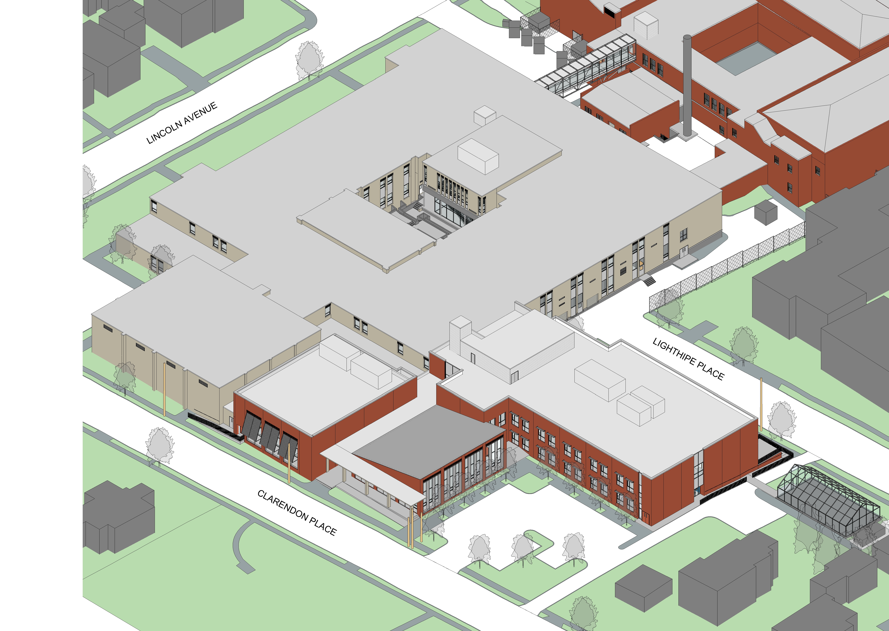
Orange High School

Slide 64
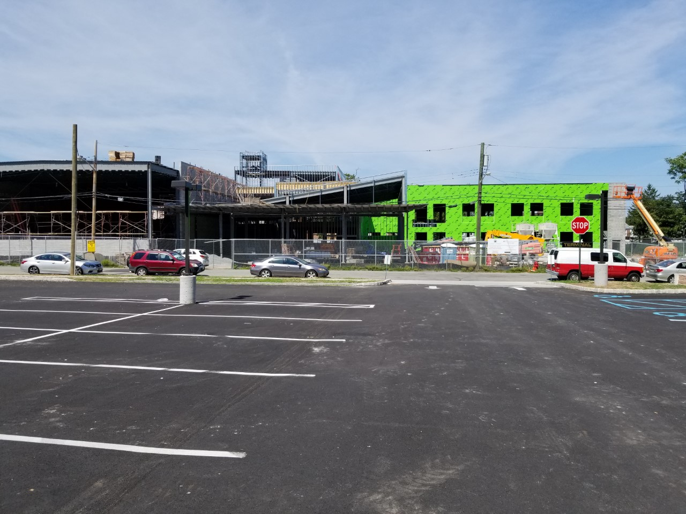
OHS Addition & Renovation Project (Ongoing)

Slide 65
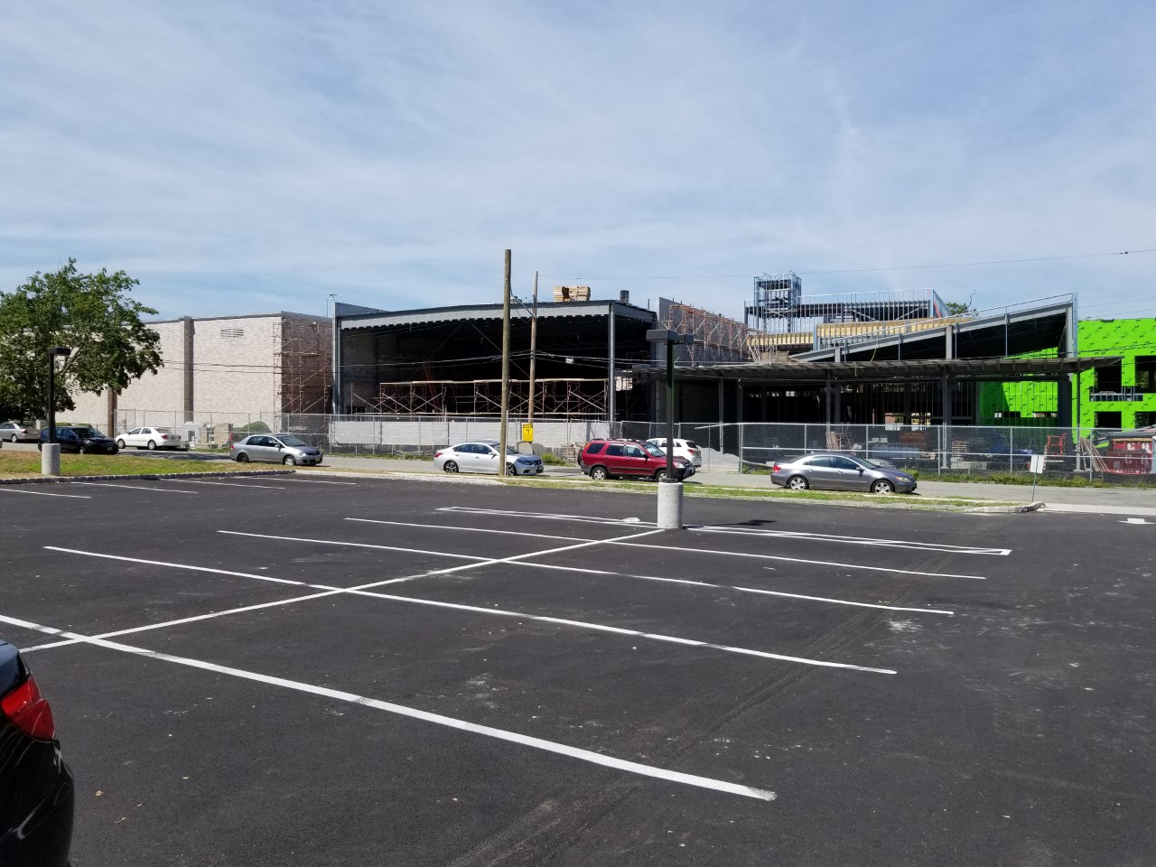
OHS addition & Renovation

Slide 66
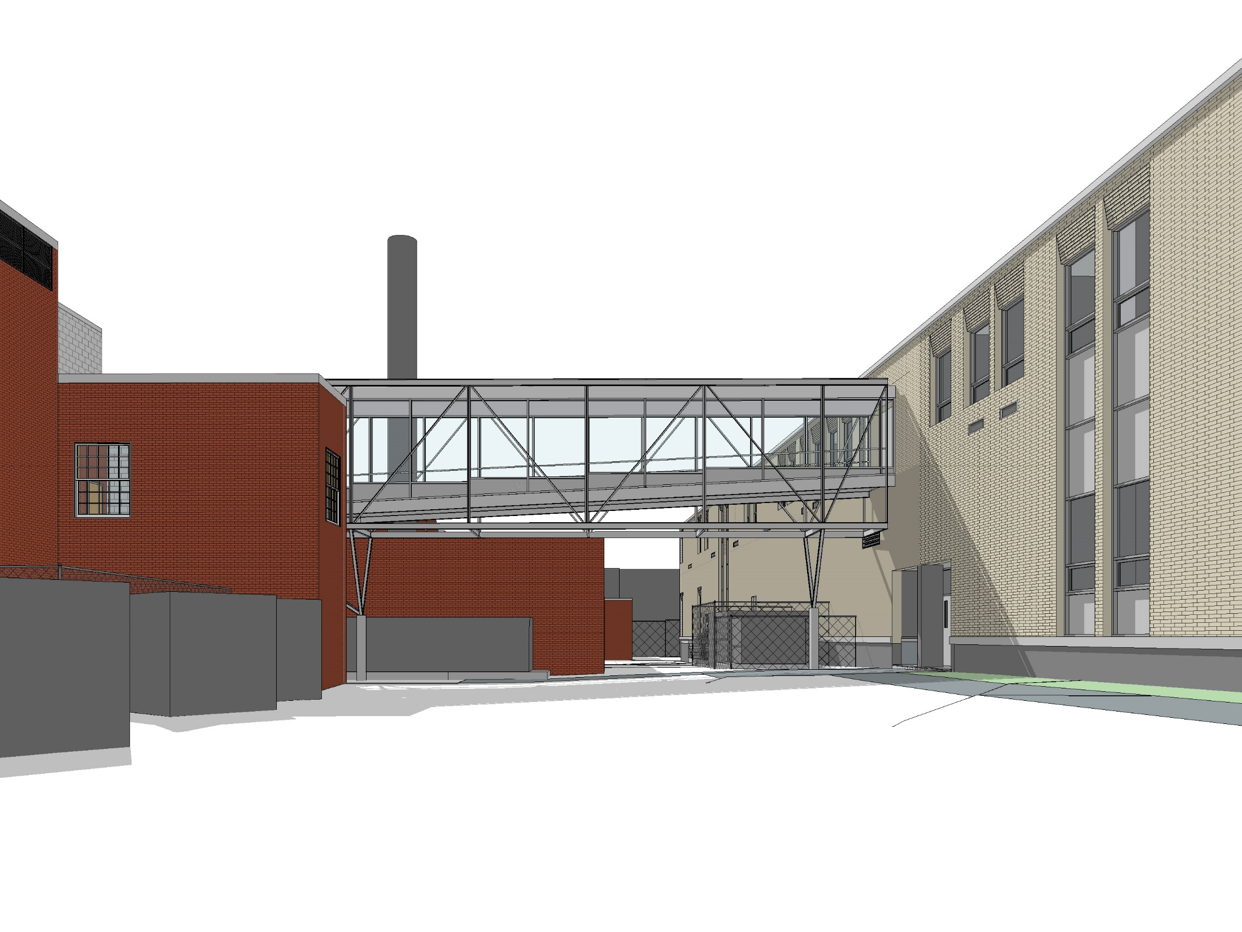
Orange High School

Slide 67


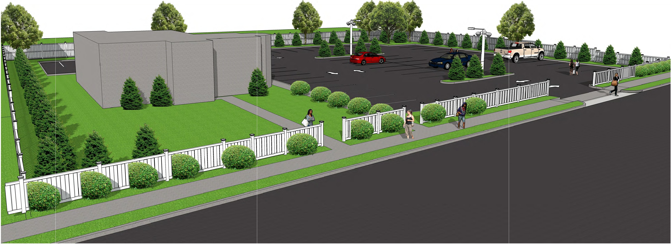
x
YEZZI ASSOCIATES
ARCHITECTURE
PLANNING
ENGINEERING
INTERIORS
MANAGEMENT
Daniel M. Sernotti
Architect No 21AI01897900-NJ Architect No 73872 -NCARB
Signcrture
I-
Ill
<( -.\)
Ill u- _J
I- l'I\ IL
O a z
_J z Q
I.I) <( ['I
z -.\l z
y_ Ill
Ii l'I\ Ii
<(
<( ill
IL -ct
Pro}9cl. Bld Dahl
ReYWon1 By
3D VI EJ;\I 2
P-3 'SC-ALE: N.T.S
3D VIEH 2
GP
Chk'd By
4
HFY
N_O_
T_F_o_
R_c o_N_S_T_R_u_c_T_l_o_N_l l-o,-cjo-cl - ."B ,,
Do Not Scale Draw ings - Field check all dimensions prior to start of construction

Slide 68
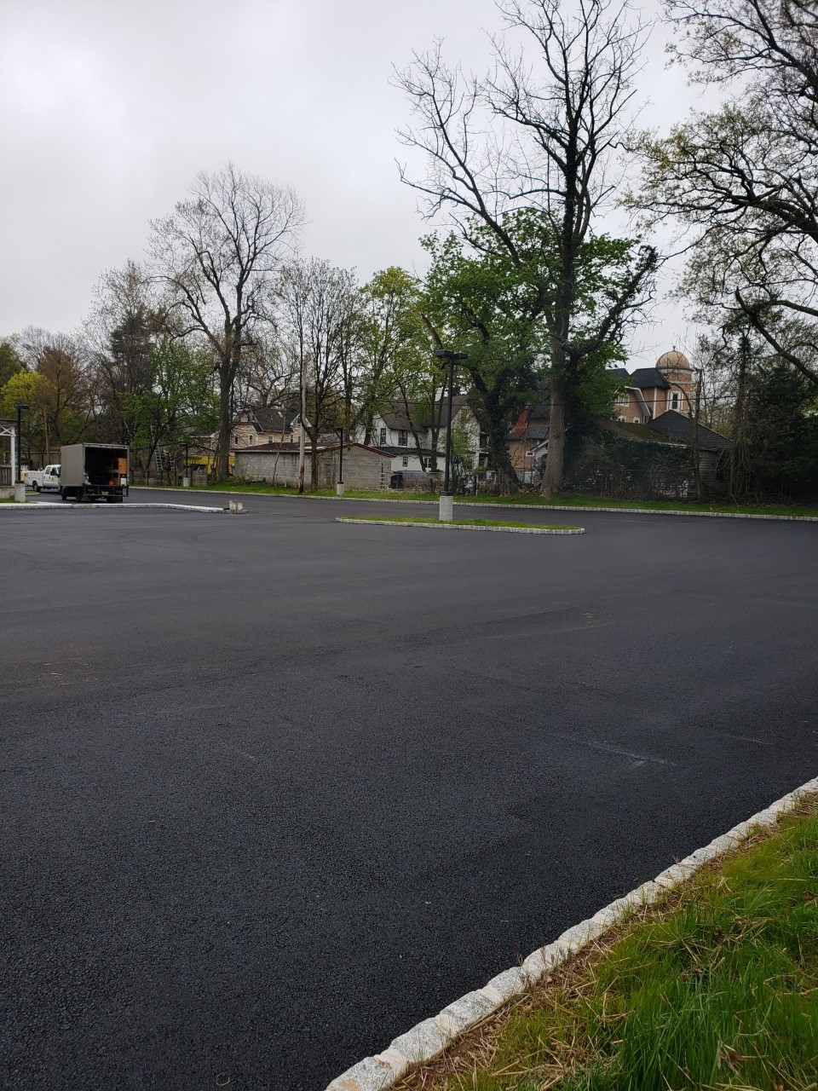
OHS Parking Lot

Slide 69
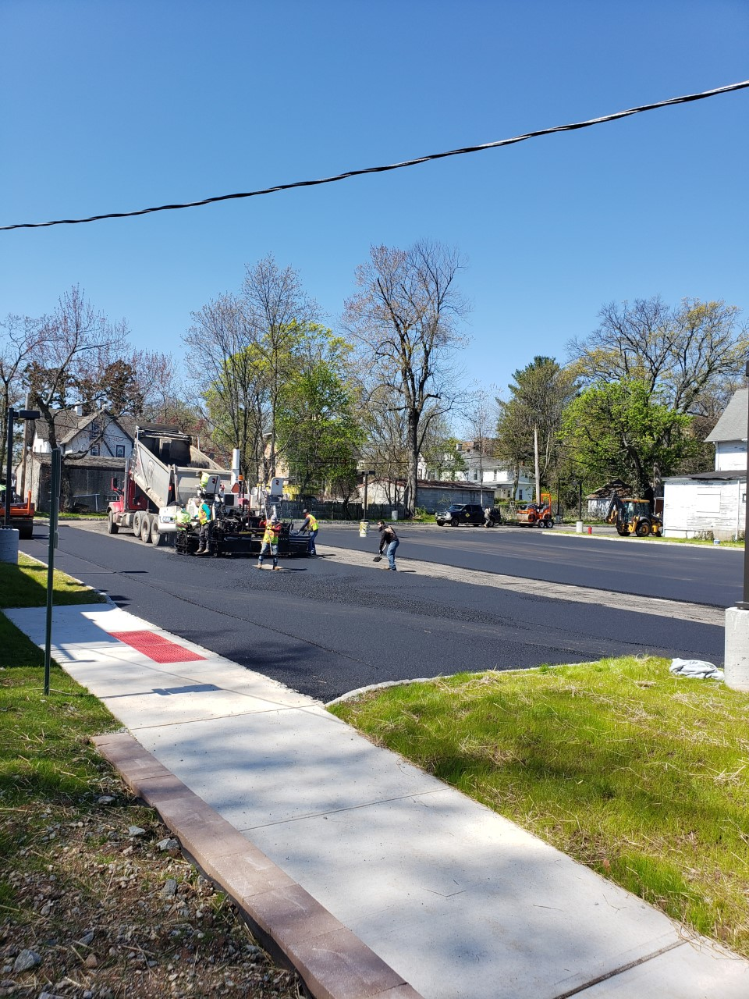
OHS Parking Lot

Slide 70
SDA PROJECT- Cleveland Elem. School
Addition/Renovation
Additions:
Multipurpose room (4,800 SF) with Stage (1,200 SF)
Prep. Kitchen with server (1,200 SF)
Main Lobby & Security Post
Boys & Girls rest rooms (on 3rd Floor)
Program-driven Renovations:
Child study team space
Small group instruction space
Toilets for Nurse’s office & Staff (on each floor)
Art & Science Project labs
Self-contained Special Education classroom
Custodial & Building support space
Cleveland Elm. School has been relocated to Our Lady of the Valley School while construction is ongoing (approx. two & half School years)

Slide 71
CLEVELAND ELM SCHOOL
Program-Driven Renovations
Provision of child study team office space.
Provision of small group instruction space.
Provision of a toilet room in the nurse’s office.
Provision of a staff toilet on each floor of the facility.
Provision of an Art/Science Project Lab in lieu of separate Art and Science spaces.
Replacement of one Grade 6 Classroom with a Science Lab (incl. support).
Provision of one self-contained special education classroom.
Provision of custodial and building support space as feasible

Slide 72
CLEVELAND ELM. SCHOOL Renovations Cont.
Exterior
Replace existing EPDM roof
Limited masonry repointing
Lower level water infiltration and exterior grading
Roof downspout discharge and site drainage
Fencing
Parking Lot Repair

Slide 73
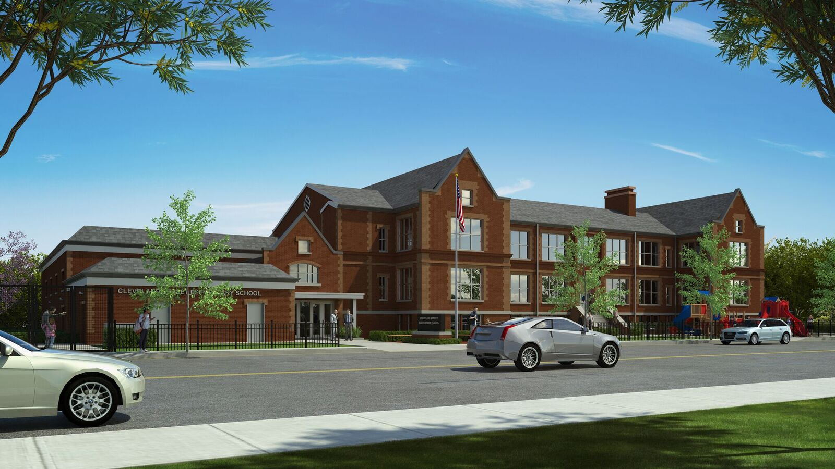

Slide 74
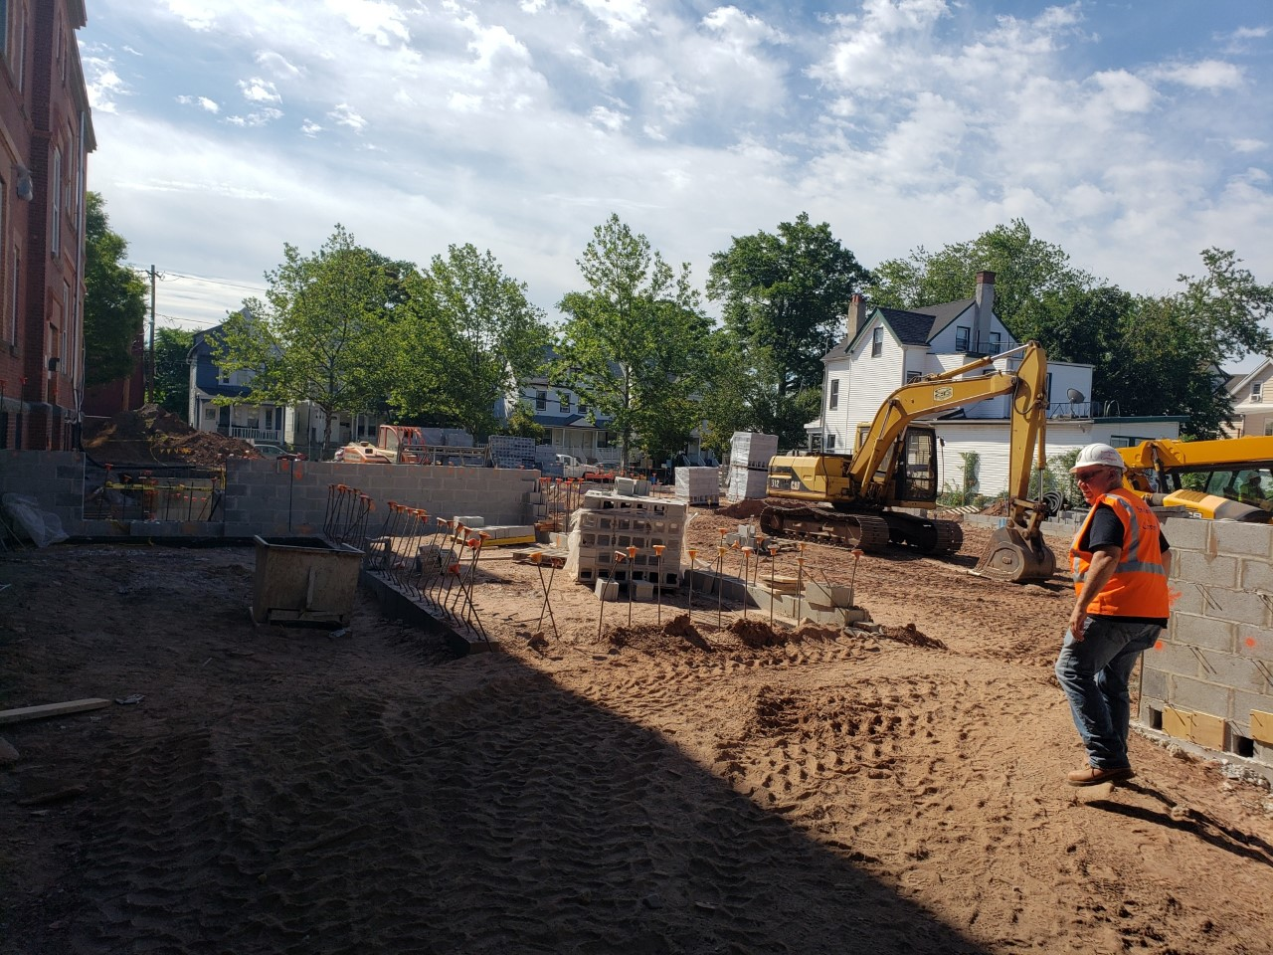
Cleveland Street School Renovation/Addition In Progress

Slide 75
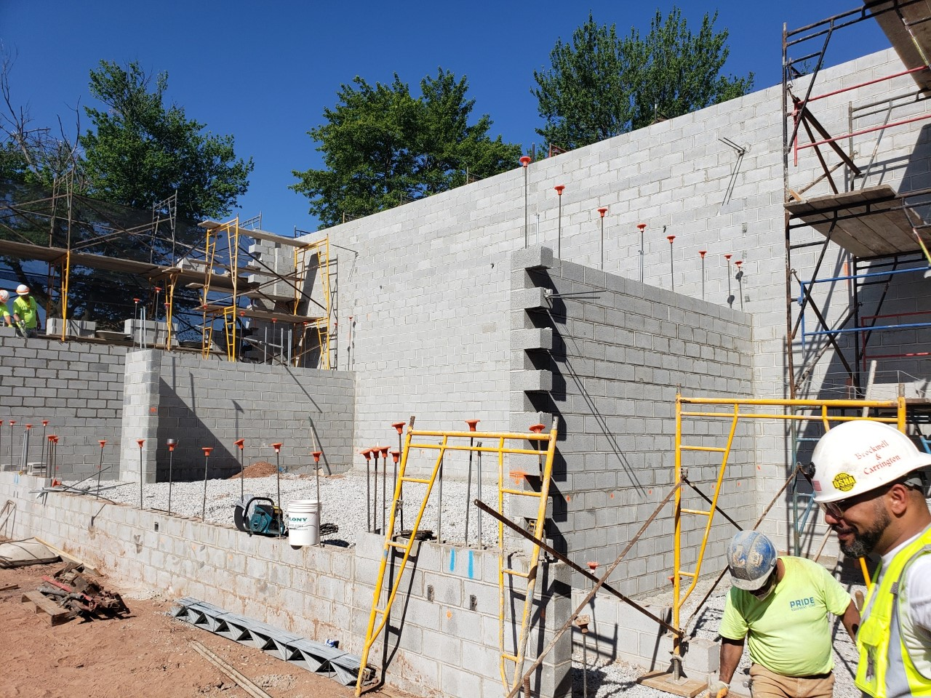
Cleveland Street School Renovation/Addition In Progress

Slide 76
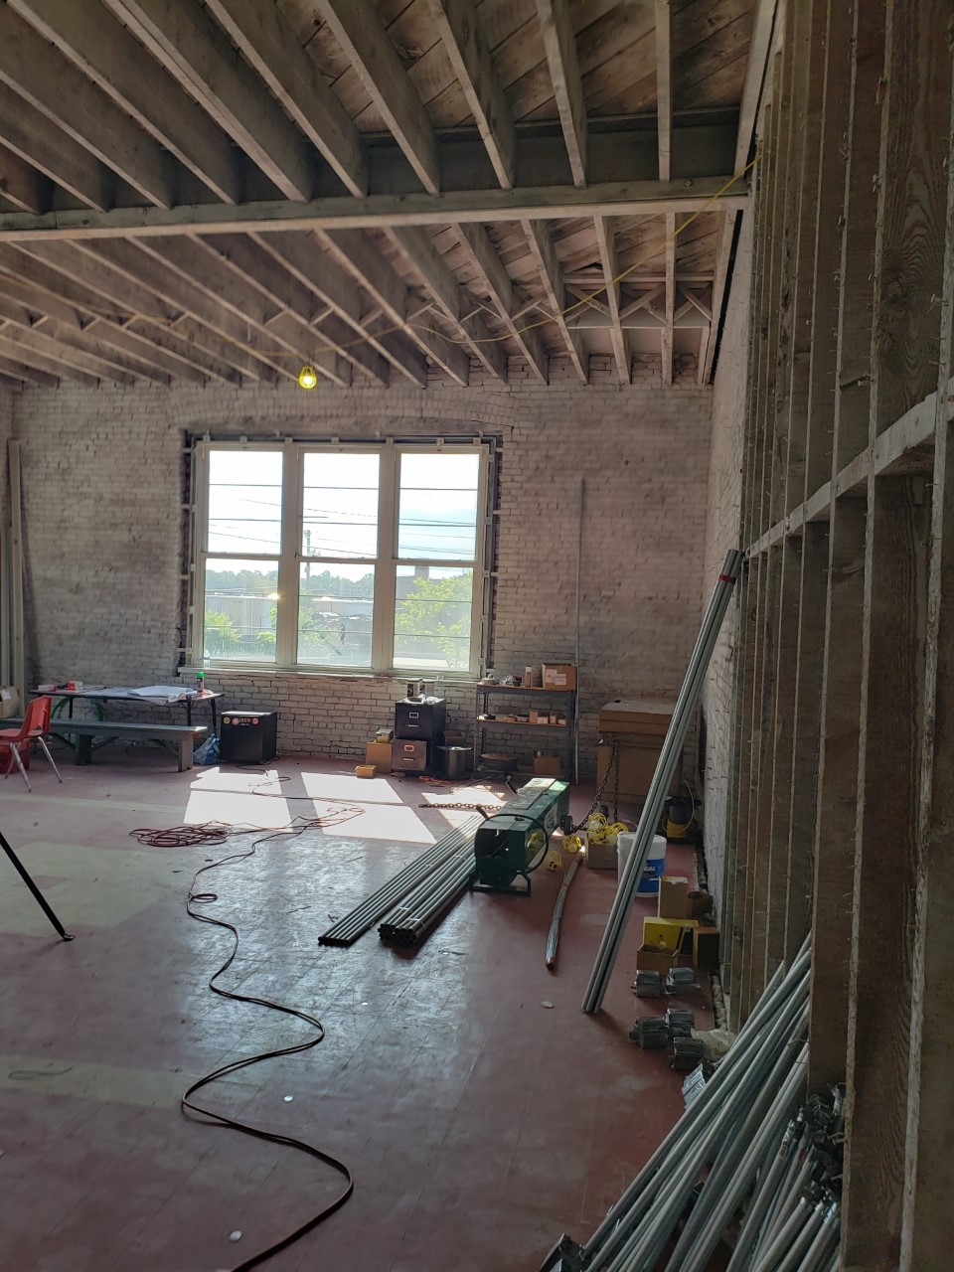
Cleveland Street School Interior Renovation In Progress

Slide 77
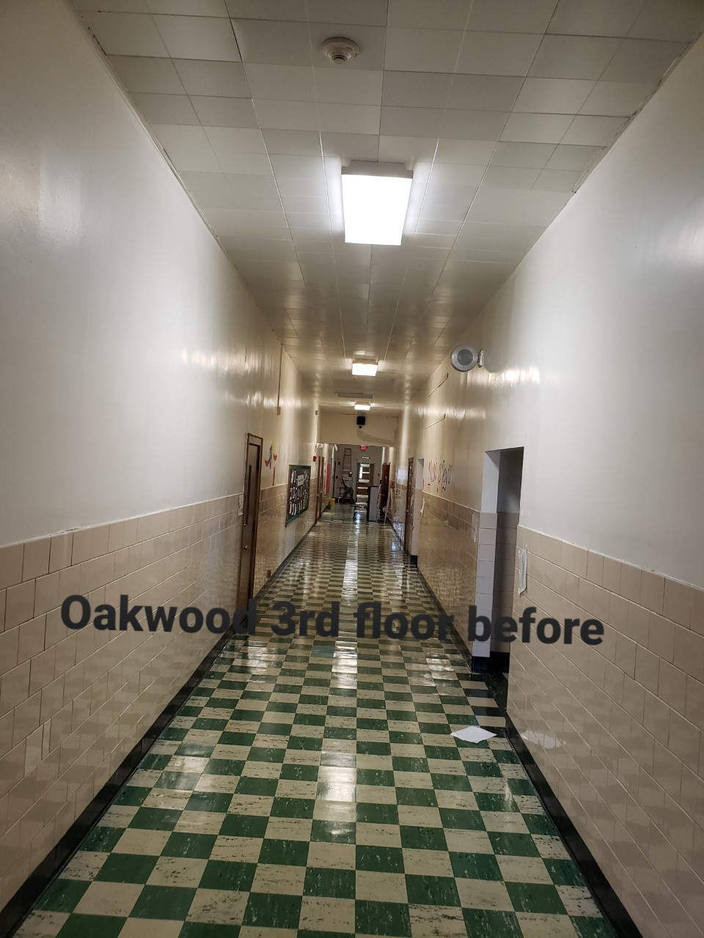
Oakwood Avenue School Interior Hallways Renovation In Progress

Slide 78
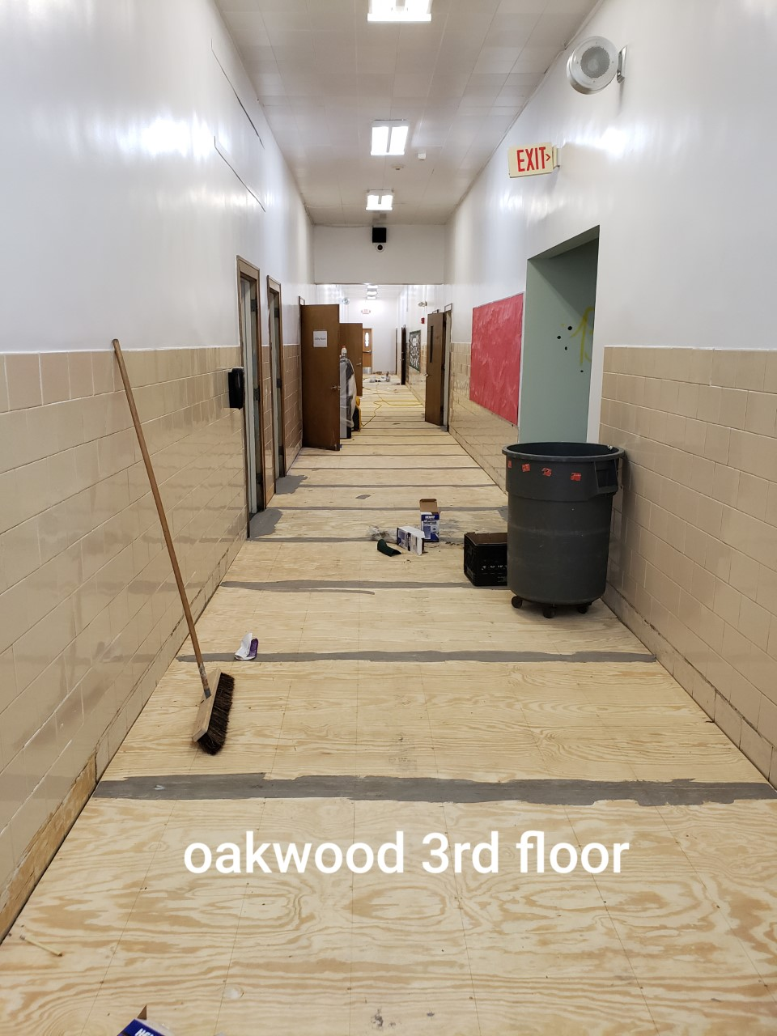
Oakwood Avenue School Interior Hallways Renovation In Progress

Slide 79
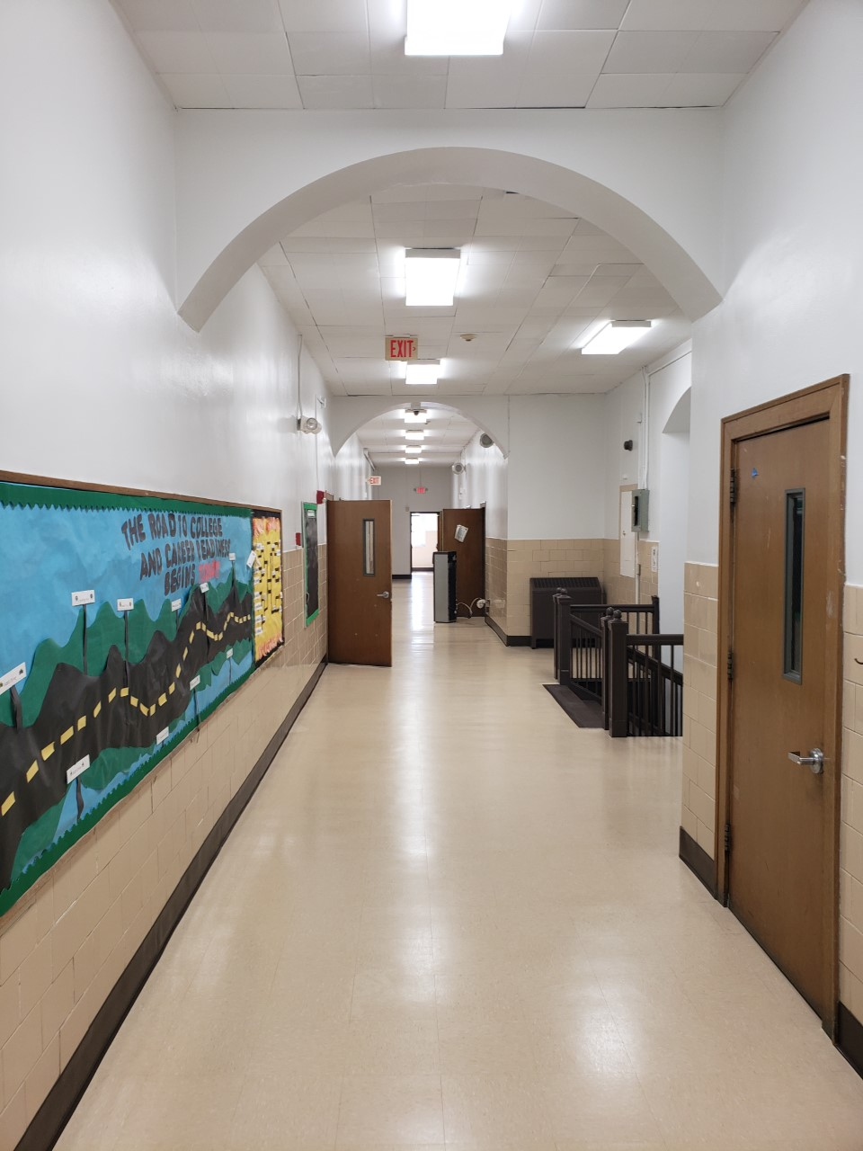
Oakwood Avenue School Hallway Renovations

Slide 80
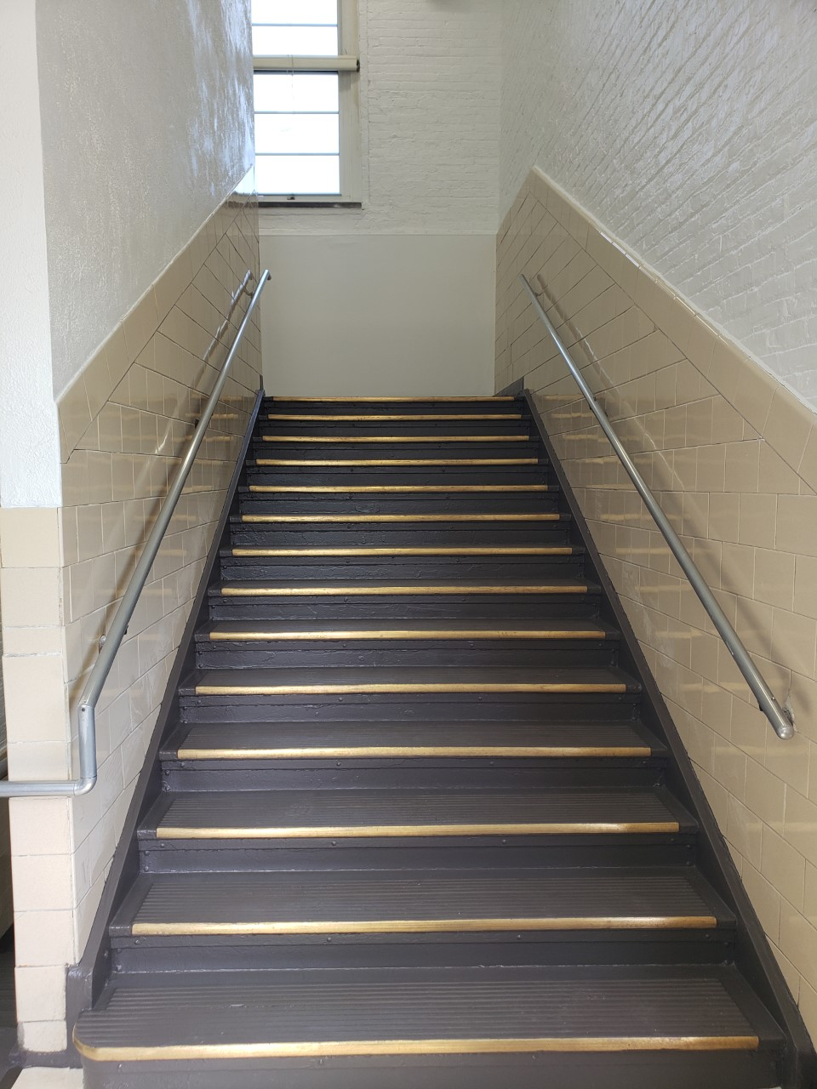
Oakwood Avenue School Stair Well Renovation

Slide 81
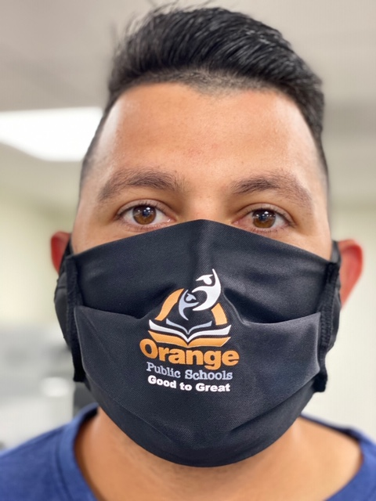
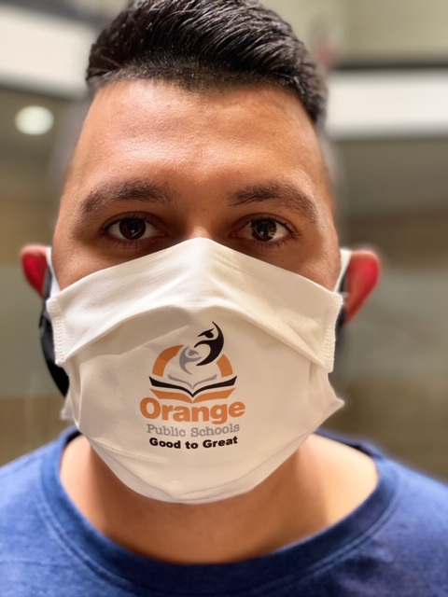
COVID-19 SCHOOL REOPENING SAFETY PLAN

Slide 83


COVID-19 SCHOOL REOPENING SAFETY PLAN

Slide 85
Custodial Maintenance
PCI Ongoing District Facilities Cleaning Updates
Landscaping – District-wide
Internal renovation projects:-
Central Elm School
STEM, Oakwood
123 Cleveland Street
General Summer Cleaning- scheduled & ongoing

Slide 86
Welcome from Faith Alcantara
Ms. Faith Alcantara
Union President of the Orange Administrators and Supervisors Association
September 1, 2020

Slide 87
Welcome from Lisa Catanzarite
Ms. Lisa Catanzarite
Union President of the Orange Education Association
September 1, 2020

Slide 88
District Goals
Gerald Fitzhugh, II, Ed.D.
Superintendent of Schools
“The Teaching Superintendent”
September 1, 2020

Slide 89
District Goals
School Year 2020-2021
Goal #1: 21st Century Integration: The Orange Public Schools will continue to invest in its teachers. The district values and promotes a culture of excellence in teaching and learning through increased and improved opportunities for quality, sustained professional development that address district needs and individual school needs as outlined by data points.
100% of Professional Learning Communities will be utilized as leverage points for sharing best practices which ultimately will enhance student achievement
Professional Learning Communities will continue to be instructional in nature. The principals alongside district administrators will continue to structure the agendas around academic data points that will be targeted and monitored for improvement.
Data reviews will allow for strategic planning and preparation in the effort of maximizing lesson delivery. Data reviews will take place four times per year and encompass academic growth and/or decline and recommendations for growth, walk through analysis, suspension rates as well as office referrals that ultimately impact student achievement.

Slide 90
District Goals
School Year 2020-2021
Increase in the number of job-embedded professional learning opportunities that incorporate the expertise of building principals planning alongside district administration by 50%
Administrative Meetings will be instructionally-focused learning sessions for principals and district administrators. Ultimately, all training sessions will be germane to data points resulting from walk-through trend analyses.
Administrative meetings will have instructionally focused agendas with accompanying sign in sheets. Zoom meeting will take place for horizontal and vertical articulation supports to build content knowledge and pedagogy.

Slide 91
District Goals
School Year 2020-2021
Increase the number of students participating in district programs such as STEM, Debate, Science Mathematics Fairs as well as the District Spelling Bee, Law Day, and Geography Bee by 25% (Due COVID-19 we did not accomplish this goal)
Provide a variety of opportunities for students to demonstrate the relevance and interconnectedness of their knowledge and skills
4) By May 2021, 60% of students in each preparedness group will meet or exceed their assigned end of year growth target in mathematics.
The assessments that will be used to measure progress towards the assigned growth targets include the iReady Diagnostic, NWEA MAP, District Benchmark Assessments, and select Performance Tasks in the area of Mathematics.
By May 2021, 60% of students in each preparedness group will meet or exceed their assigned end of year growth target in ELA.
The assessments that will be used to measure progress towards the assigned growth targets include the FRA, SRI, Insight, District Benchmarks, and Performance Tasks in the area of English Language Arts.

Slide 92
District Goals
School Year 2020-2021
Goal #2: Community Engagement: The Orange Public Schools continue to develop a consistent communication system for disseminating and receiving information between school administration, teachers, staff, students, parents, and the community.
Increase the timeliness, access, and effectiveness of all communication with all stakeholders via multiple measures by 35% from the previous school year
Social Media Platforms & Website (Instagram, Facebook, and Twitter)-Utilize the platforms for immediate news worthy information as well as the district website via the latest news and announcements section.
RoboCalls via School Wires at the district and school levels; we are incorporating more text to speech and emails for SY 20-21 at 25%.
Superintendent’s Report (online access to staff and community stakeholders) the day immediately following the board meeting.
Routine face-to-face opportunities to engage with community and stakeholders via PTO, Back to School Nights, Report Card Conference Nights, Community Events within Orange Township as well as partnership meetings based on those established and forthcoming within the school district. We will establish parent and student councils at the Superintendent’s Level.

Slide 93
District Goals
School Year 2020-2021
Increase the use of emerging and available communications outlets to transmit information by 30%
Partner with universities (local and throughout the state) in order to get information to prospective candidates for job fairs and other industry level announcements. As a result of the COVID-19 pandemic, we will conduct virtual job fairs as well to widen the search for potential candidates outside of the University realm
Utilize the Orange Public School App for more timeless information
Utilize the Emergency Pop Up on the website for transmitting important, time sensitive information weekly
Enhance the overall quality and timeliness of information and resources provided on the District’s website and by virtual measures (via blasts, email, and text message) by 30%
Provide weekly updates via the district website relevant to school and district initiatives
Update parent portal in Genesis so parents in all schools have full access upon authorization

Slide 94
District Goals
School Year 2020-2021
Create Parent and Student Councils
Have monthly meetings with parents and students about academics as well as self-care supports; student council meetings will take place separately from the parent council.

Slide 95
District Goals
School Year 2020-2021
Goal #3: Facilities and Finance
The Orange Public Schools will continue to redesign the fiscal management, operations, and human resources of the organization to ensure a system of accountability, transparency, and efficiency for the optimal delivery of services. Due to the COVID-19 pandemic, unforeseen expenses at the state and local level resulted in FY21 budget cuts to both district and school-based budgets; therefore, funding must be realigned to meet the needs of students and staff.
Create a district budget under constraints that accommodates and supports the needs of central office departments, all schools and students while sustaining systems that have yielded results through a strategic assessment of data
Analyze and clarify how all budgeted funds are allocated and expended at the department and school levels
Examine and evaluate contracted services provided to the district and continuously improve effectiveness
Identify and execute capital projects (short term/long term, prioritized, and categorized on the basis of need)

Slide 96
District Goals
School Year 2020-2021
Goal #3: Facilities and Finance
The Orange Public Schools will continue to redesign the fiscal management, operations, and human resources of the organization to ensure a system of accountability, transparency, and efficiency for the optimal delivery of services. Due to the COVID-19 pandemic, unforeseen expenses at the state and local level resulted in FY21 budget cuts to both district and school based budgets; therefore, funding must be realigned to meet the needs of students and staff.
2) Implement innovations that empower departments and schools to properly and efficiently allocate funding within their locations.
Design a floor plan that will provide departments and schools with a blueprint of essential instructional and non-instructional positions.
Establish an appropriate framework with criteria and guidance for each administrator to customize the budget and resources based on specific department and school needs.
Improve the recruitment, staffing, professional development, evaluation, coaching, retention, and promotion of all staff that will result in a pipeline for career continuum, capacity building and succession planning.

Slide 97
District Goals
School Year 2020-2021
Goal #4: Social and Emotional Supports
The Orange Public Schools will continue to ensure that all students will receive social and emotional support to become adaptable, confident citizens who embody self-awareness and strong interpersonal skills, and who are capable of responsible decision-making and managing their emotions and behaviors.
Provide research-based curriculum to strengthen students’ social/emotional relationships
Provide additional supports in Restorative Practices to ensure that the whole child is developed through reflective yet informative social and emotional practices. This will be captured by a decrease of Administrative Hearings at the district level by 15% as well as a districtwide decrease in suspension rates by 15% from 2018-2019 (as 2019-2020 was impacted by COVID-19 emergency school.)
Increase the involvement of guidance counselors and social workers in the effort of understanding student triggers and needs for support by 15%
Enhance community-based partnerships in order to assist students and families
Utilize the District’s community engagement officer to assist school-based staff with establishing partnerships to support families and students
Provide self-care supports for families based on surveys as well as discussion with support staff members

Slide 98



Orange Public Schools Social Media
Social Media Hashtags:
#GoodtoGreat
#FROrange
#OrangeStrong
Follow us:
- Orange Public School District
- @ops_district
- opsdistrict
- Orange Public School District
Notes:
Shanell
SL - Our education system was not designed to educate everyone equally; it is the result of “inequity by design.”

